Slide 1




GITHUB AND GIT COMMANDS
Presenter:
Sounak Sarkar(23MF3IM18)

Slide 2

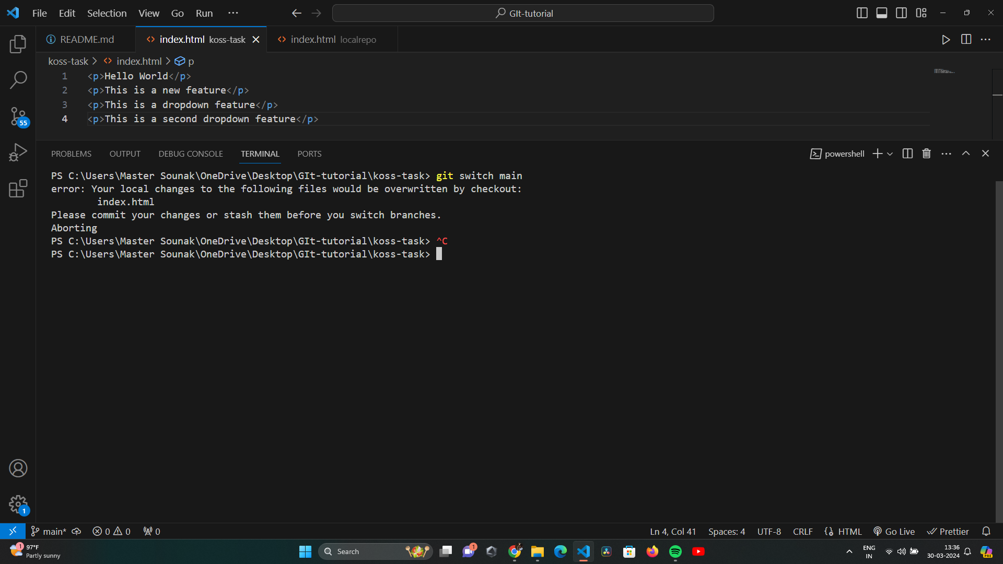
MAIN
Git won’t let me to switch branches if it detects potential conflicts
FEATURE 1

Slide 3
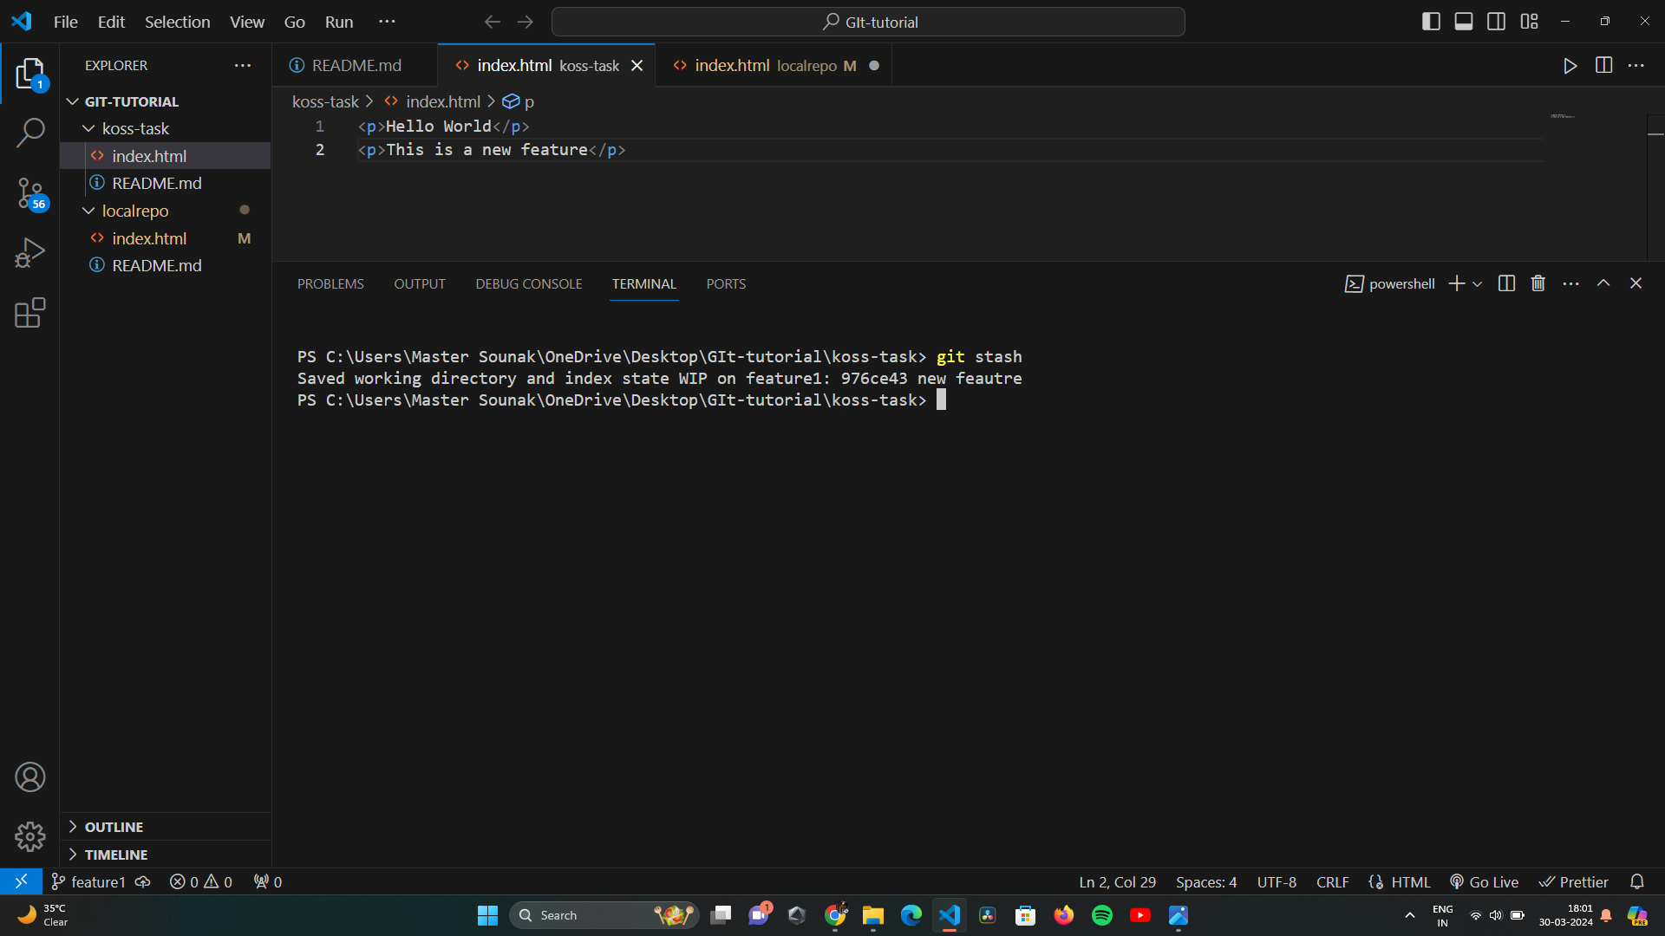
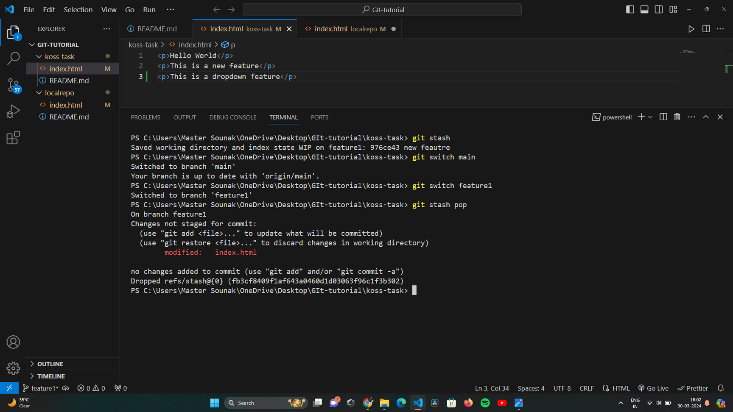
GIT STASH
Git stash is super useful command that helps you to save changes that you are not ready to commit yet. You can stash changes and come back later.
GIT STASH POP
Use git stash pop to remove the most recently stashed changes and reapply them to your working space.

Slide 4
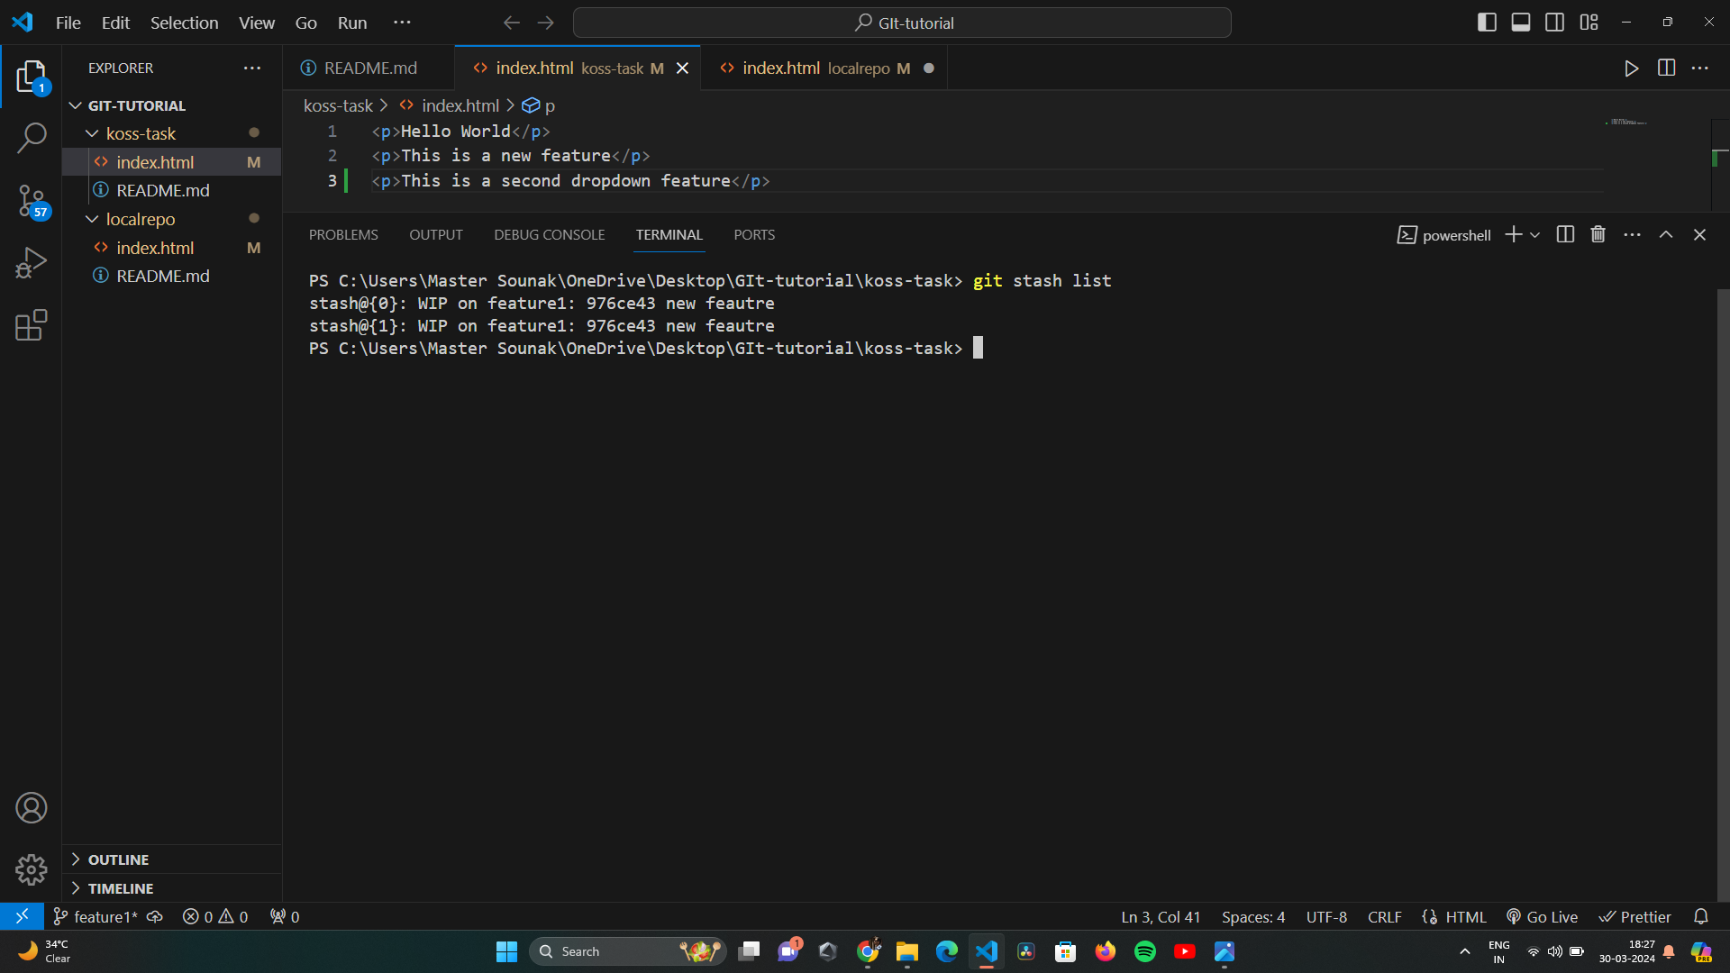
GIT STASH APPLY
You can use git stash apply to whatever is stashed away, without removing it from stash. This can be useful to stash multiple branches.
GIT STASH -u
If you have untracked files, they will not be included into stash.
To include untracked files use the -u option.
Viewing all Stashes

Slide 5
GIT BISECT
This command uses a binary search algorithm to find which commit in your project’s history introduced a bug. You use it by first telling it a "bad" commit that is known to contain the bug, and a "good" commit that is known to be before the bug was introduced. Then git bisect picks a commit between those two endpoints and asks you whether the selected commit is "good" or "bad". It continues narrowing down the range until it finds the exact commit that introduced the change.

Slide 6
Commit 6(Head) | Back to Top Added
Commit 5 | Footer added
Commit 4 | Button 2 added
Commit 3 | Button 1 added
Commit 2 | Feature 1 added
Commit 1 | Paragraph added
BAD
Git will ask whether a particular commit is good or bad?
BISECT
GOOD

Slide 7
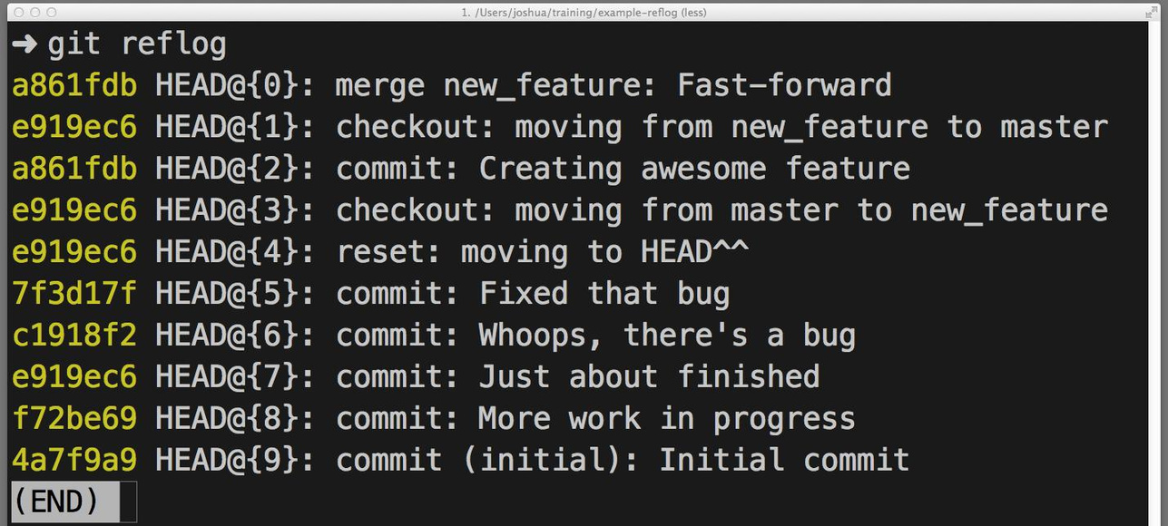
Git Reflog
The git reflog command is a built-in Git command that records the history of references, such as commits, branch creations, branch deletions, and other updates.
It is a useful tool for recovering from mistakes, such as accidentally deleting a branch or losing a commit.

Slide 8
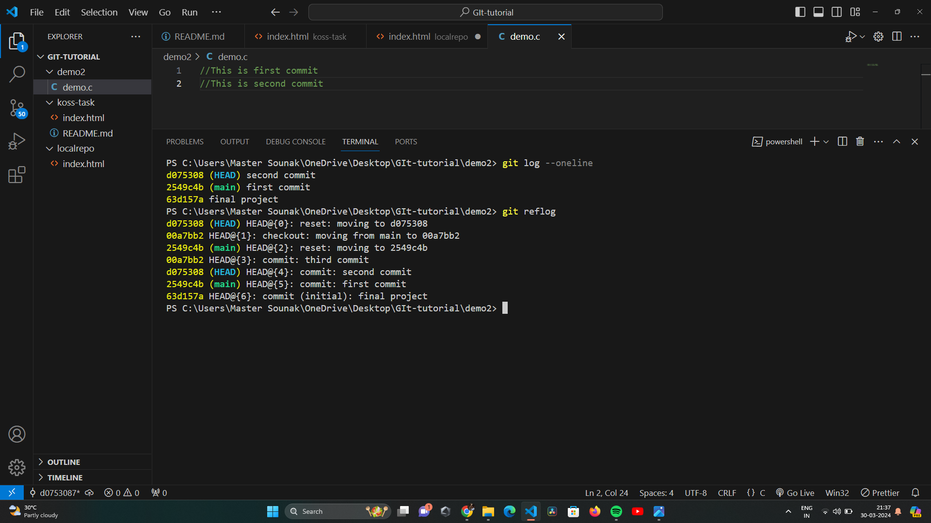
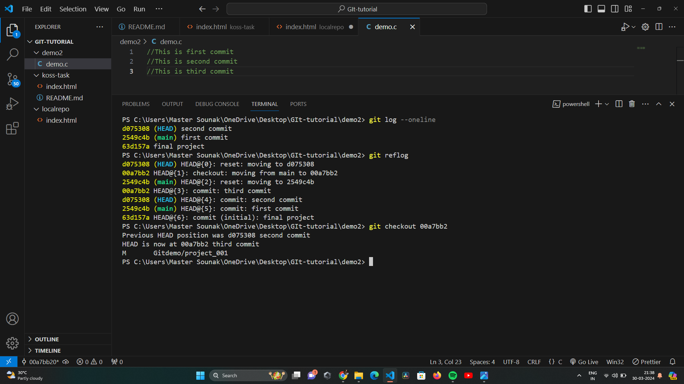
Reflog Vs Log
The log is a public record of the repository's commit history, whereas the reflog is a private, workspace-specific record of the repo's local commits.

Slide 9
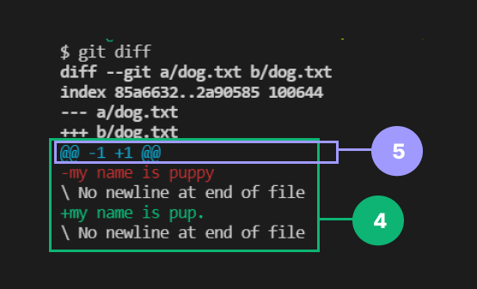
GIT DIFF
The git diff command is a versatile tool that allows you to compare different versions of your files and commits. It can be used to see what changes you have made since your last commit, to compare two different branches, or to see the changes that have been made to a specific file over time.

Slide 10
GIT DIFF
git diff
git diff --staged
git diff ref1..ref2
It shows changes between the last committed state where head is pointing and any changes we have made in our working directory
It shows changes between the last committed state where head is pointing and any files we have staged.
It shows changes between any two reference state(commits or branch).

Slide 11
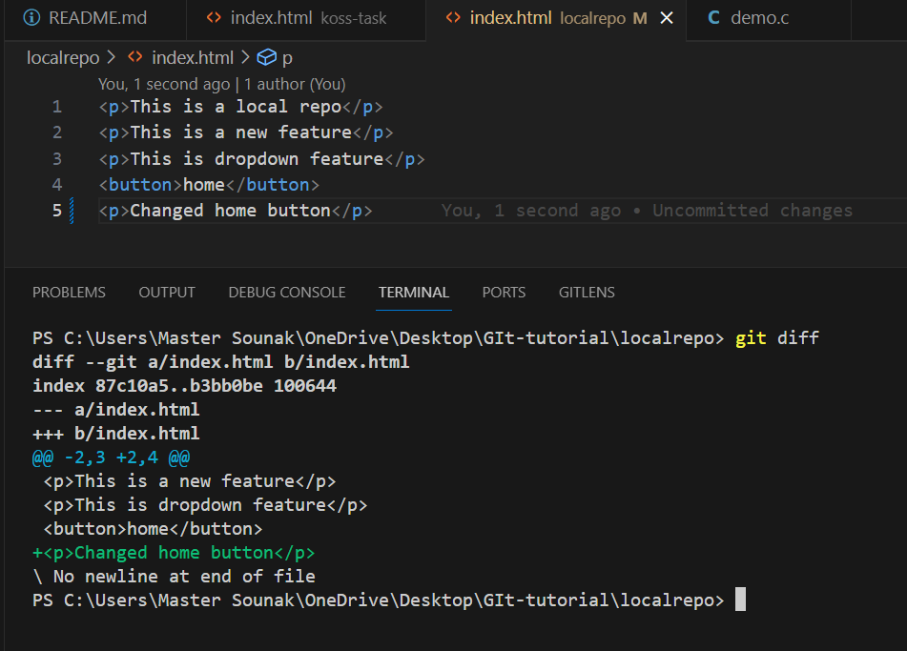

Slide 12
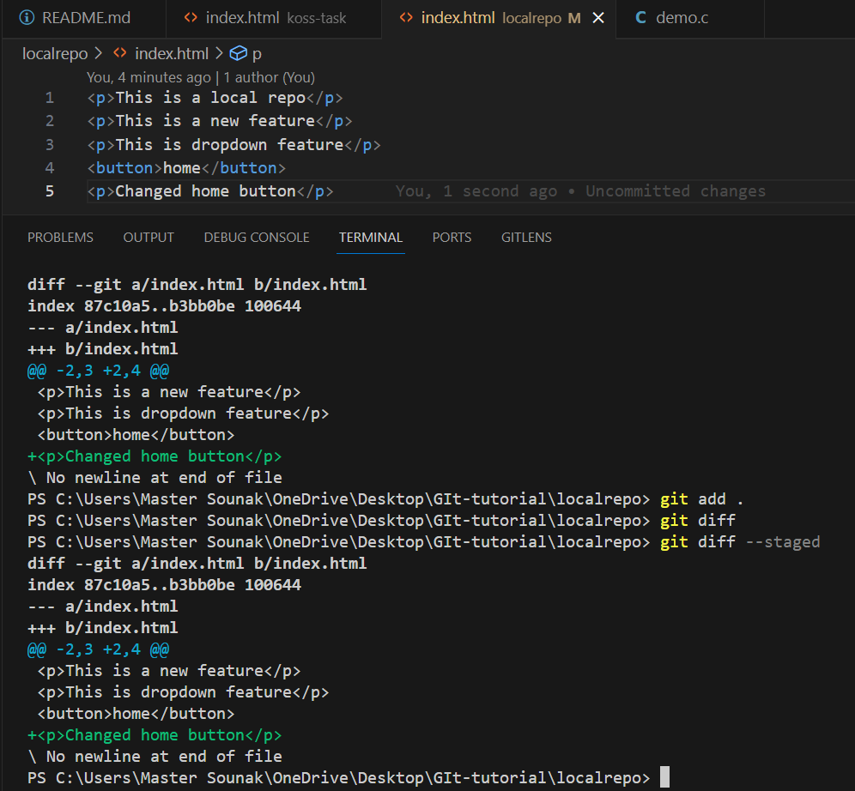

Slide 13
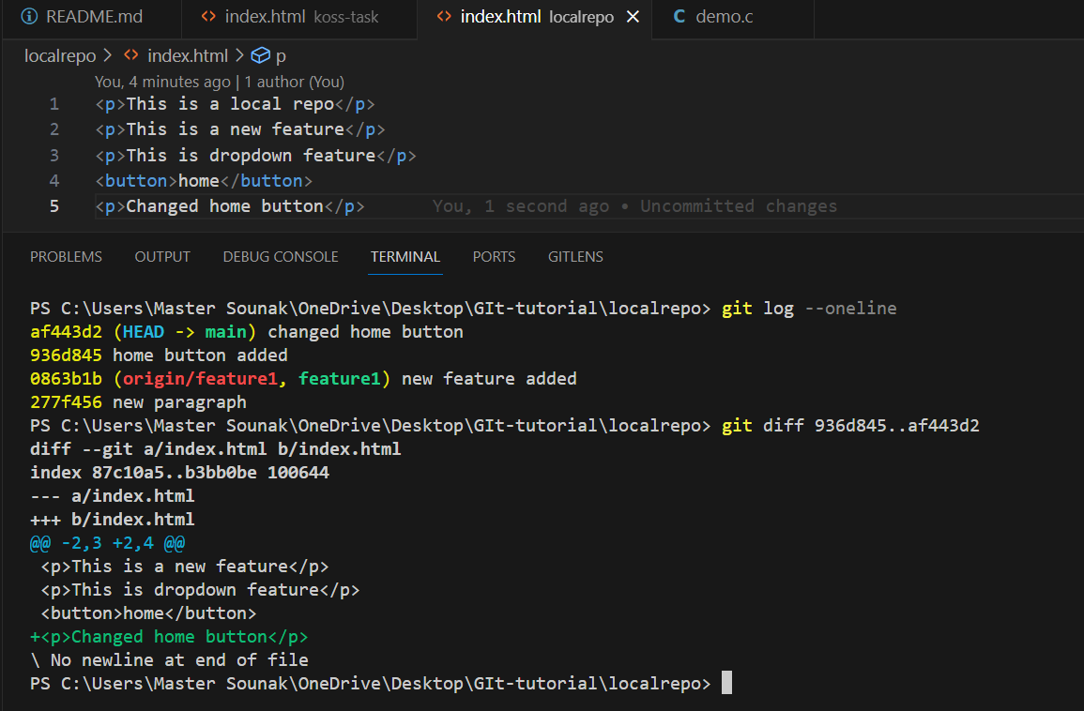

Slide 14
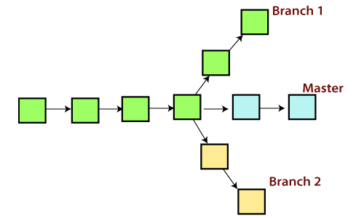
GIT SWITCH
The "switch" command allows you to switch your current HEAD branch

Slide 15
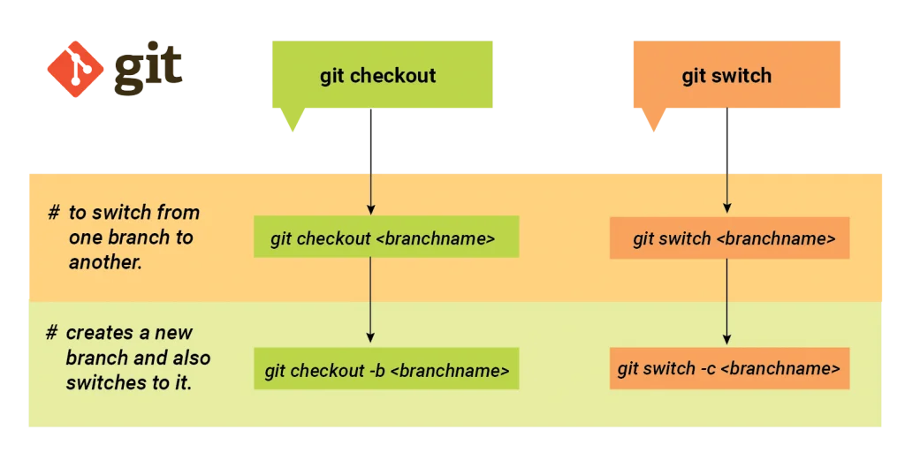
Switch VS Checkout
Before "switch" was available, changing branches had to be done with the "checkout" command. The problem with "checkout", however, is that it's a very versatile command: you can not only use it to switch branches, but also to discard changes, restore files, and much more.

Slide 16
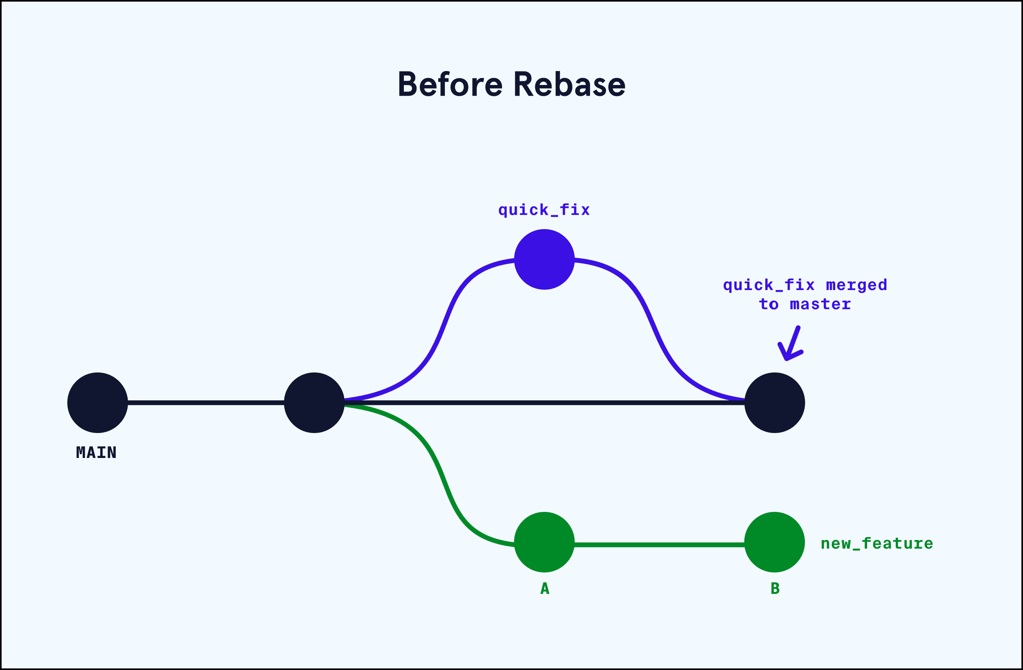
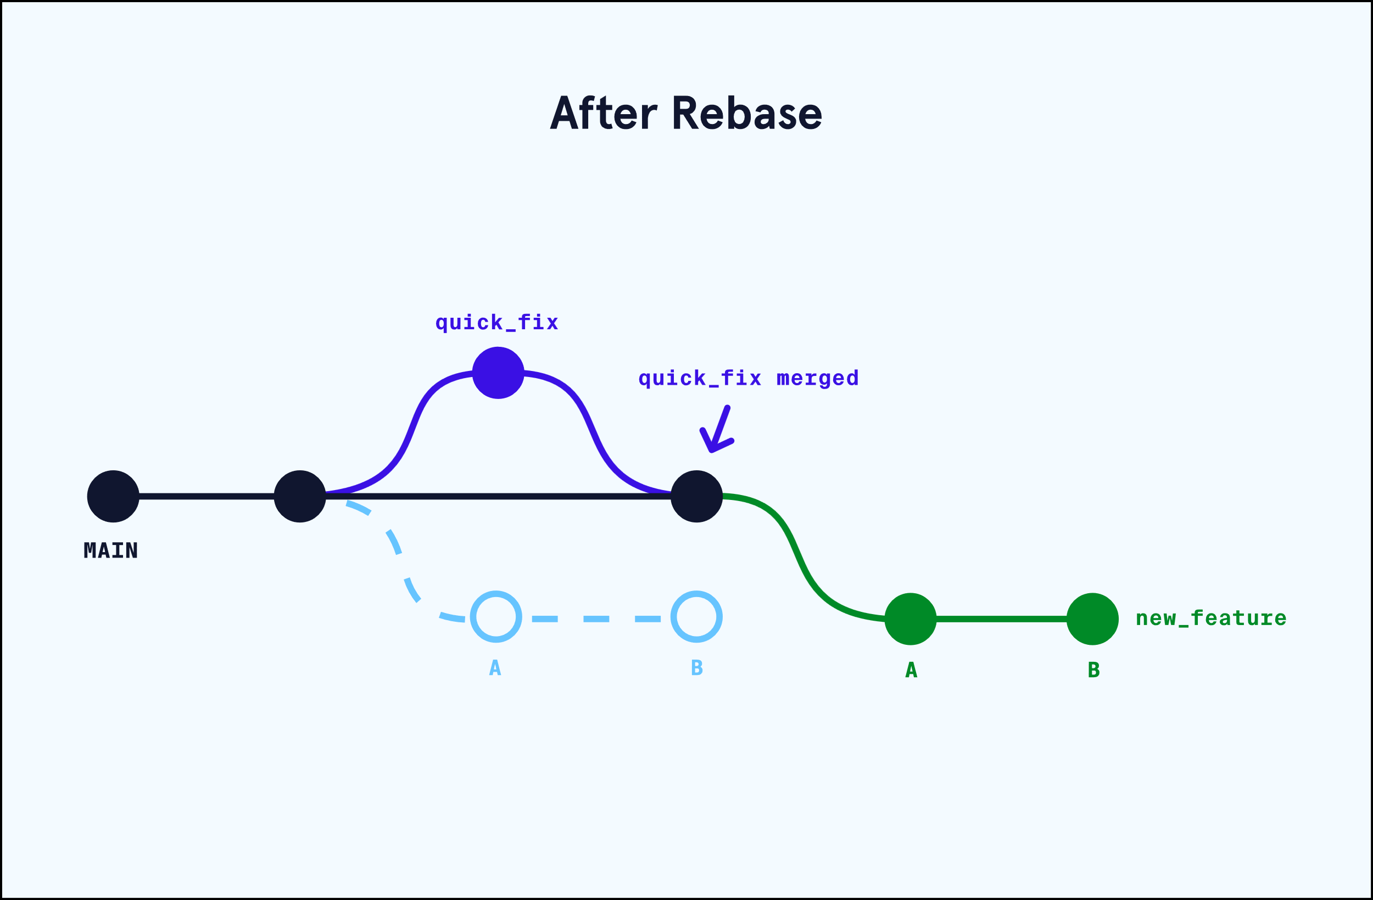
GIT REBASE
Git rebase is a command that allows you to move or combine a sequence of commits to a new base commit. It can be used to clean up your commit history, or to integrate changes from another branch into your current branch.

Slide 17
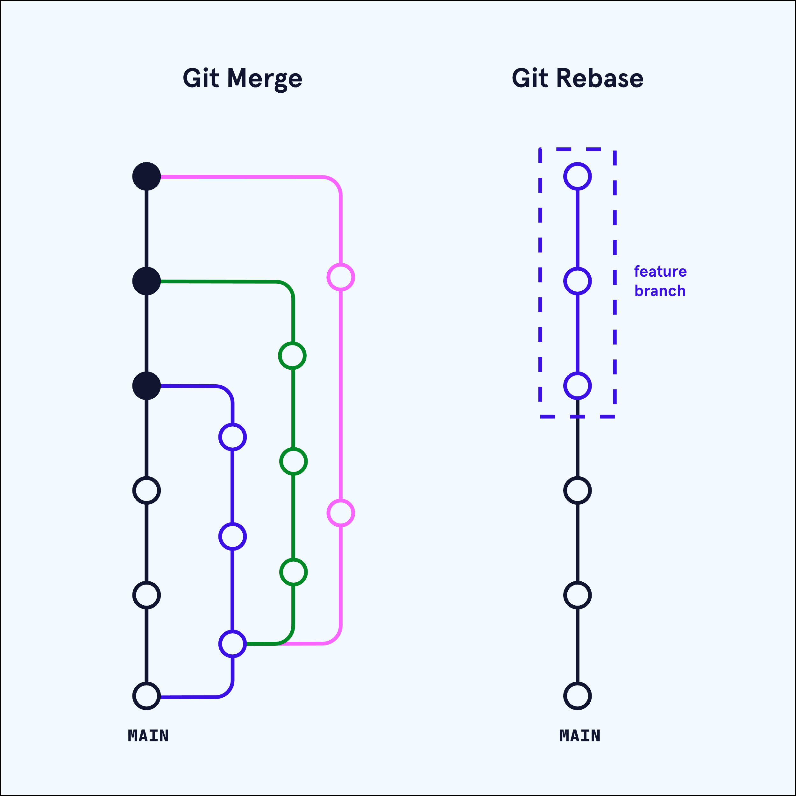
Merge Vs Rebase

Slide 18
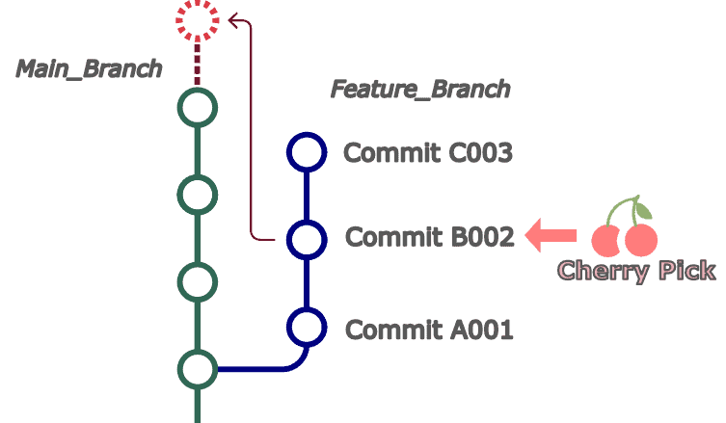
GIT CHERRY PICK
In Git, git cherry-pick is a command that lets you pick a commit from one branch and apply it to another

Slide 19
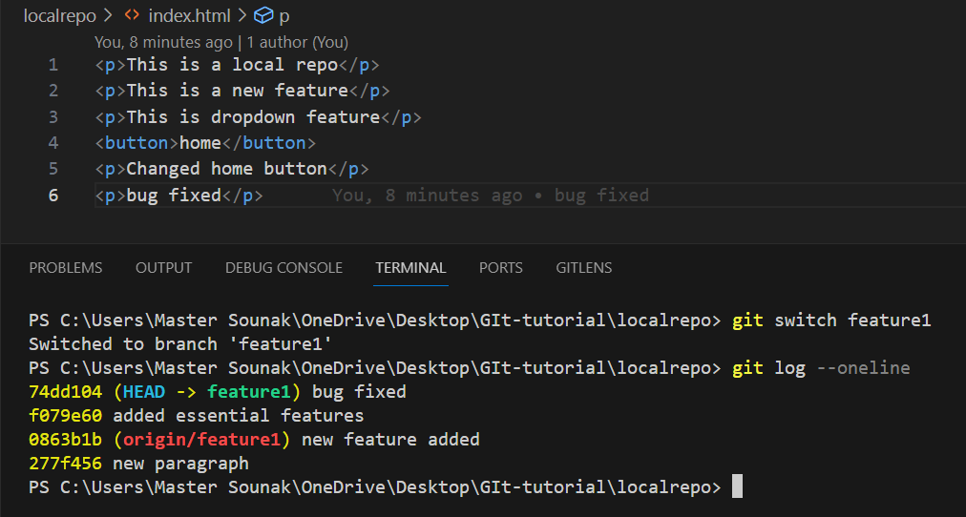
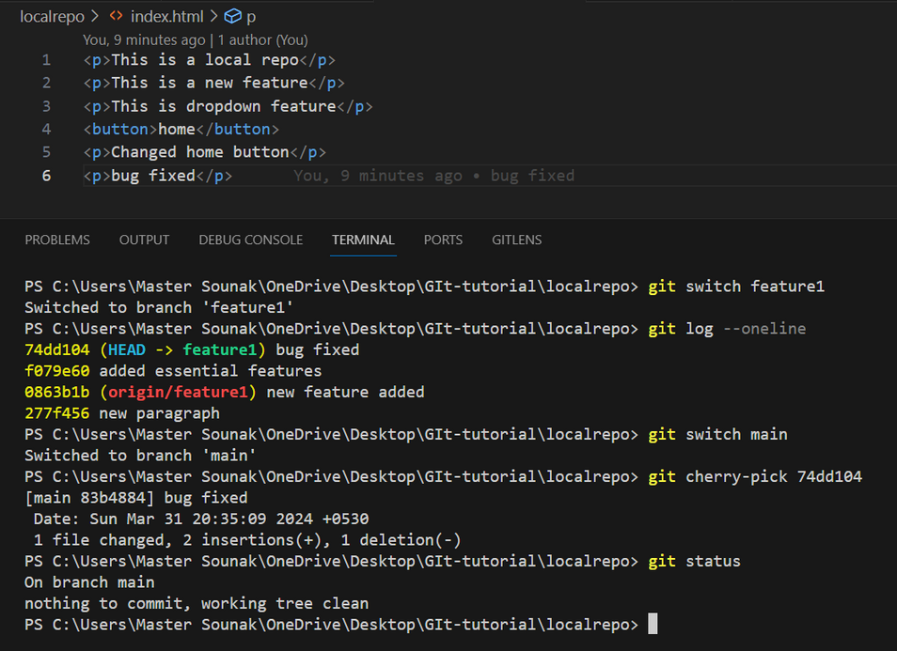
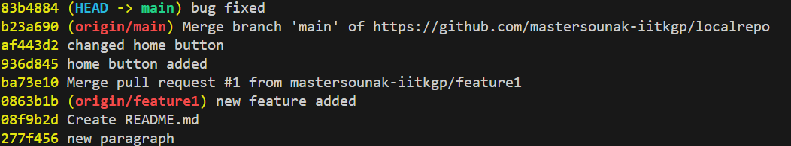

Slide 20
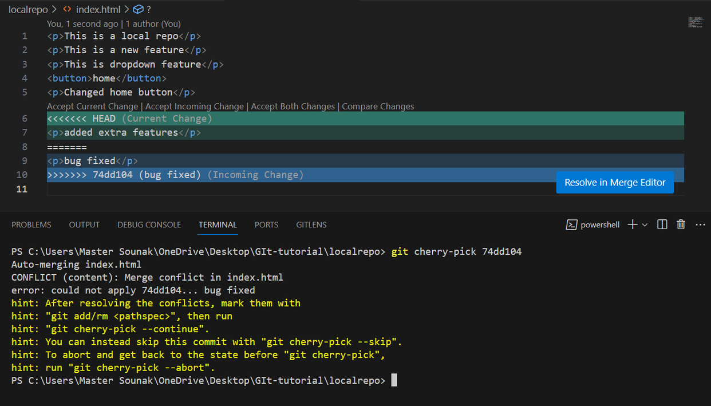
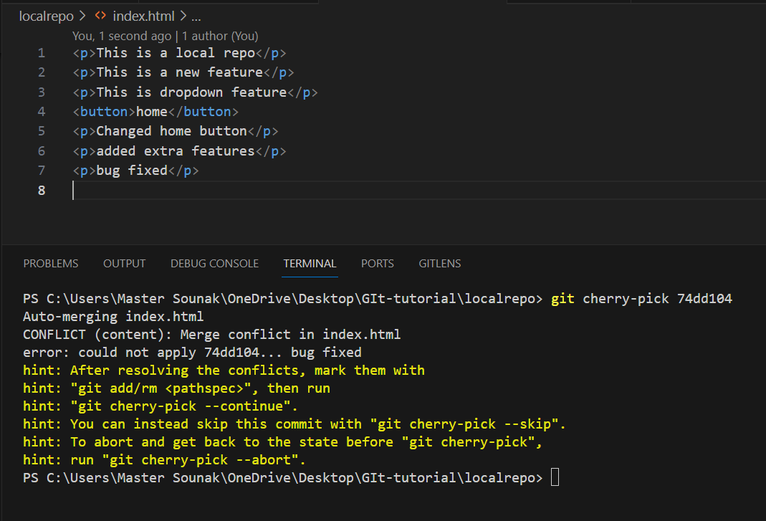
HOW TO RESOLVE MERGE CONFLICTS

Slide 21
